Slide 1
Extract, transform, load
MTN.BI.08
Core PL/SQL
Elias Nema
Senior Software Engineer
Elias_Nema@epam.com

Slide 2
Agenda
History
Main Features of PL/SQL
Variables
PL/SQL Control Statements
Cursors
How PL/SQL Runs

Slide 3
history

Slide 4
It’s all started in 1988…
In 1988, Oracle Corporation released Oracle version 6, a major advance in its relational database technology. A key component of that version was the so-called procedural option, or PL/SQL.
but …
(on the server side create “batch processing”, on a client side – procedures and functions)

Slide 5
Some SQL problems
You can GRANT a user to UPDATE some table, but you cannot ensure user will do correct sequence of changes to one or more tables.
The PL/SQL language provides tight control and management over logical transactions. Instead of granting to a user the authority to update a table, you grant privileges only to execute a procedure, which controls and provides access to the underlying data structures. The procedure is owned by a different Oracle database schema, which, in turn, is granted the actual update privileges on those tables needed to perform the transaction.

Slide 6
Pl/sql main features

Slide 7
Tight Integration with SQL
PL/SQL lets you use all SQL data manipulation, cursor control, and transaction control statements, and all SQL functions, operators, and pseudocolumns.
PL/SQL fully supports SQL data types.
PL/SQL lets you run a SQL query and process the rows of the result set one at a time.

Slide 8
PL/SQL Units
A PL/SQL subprogram is a PL/SQL block that is stored in the database and can be called by name from an application. When you create a subprogram, the database parses the subprogram and stores its parsed representation in the database. You can declare a subprogram as a procedure or a function.
A PL/SQL anonymous block is a PL/SQL block that appears in your application and is not named or stored in the database. In many applications, PL/SQL blocks can appear wherever SQL statements can appear.

Slide 9
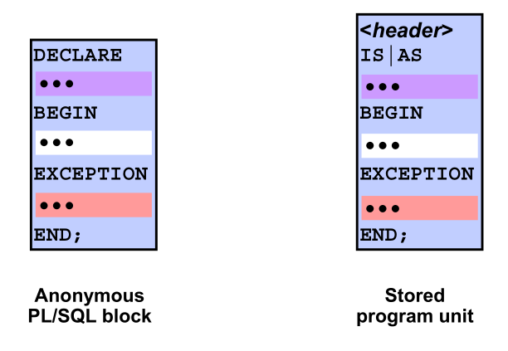
PL/SQL Blocks

Slide 10
PL/SQL Blocks
An anonymous PL/SQL block structure consists of an optional DECLARE section, a mandatory BEGIN-END block, and an optional EXCEPTION section before the END statement of the main block.
A stored program unit has a mandatory header section. A stored program unit does not have an optional DECLARE section, but it does contain an IS | AS section that is mandatory and acts the same as the DECLARE section in an anonymous block.

Slide 11
Sample Blocks

Slide 12
Subprograms and Packages
A PL/SQL subprogram is a named PL/SQL block that can be invoked repeatedly. PL/SQL has two types of subprograms, procedures and functions.
A package is a schema object that groups logically related PL/SQL types, variables, constants, subprograms, cursors, and exceptions. A package is compiled and stored in the database, where many applications can share its contents.
CREATE PROCEDURE or CREATE FUNCTION
CREATE PACKAGE or CREATE PACKAGE BODY

Slide 13
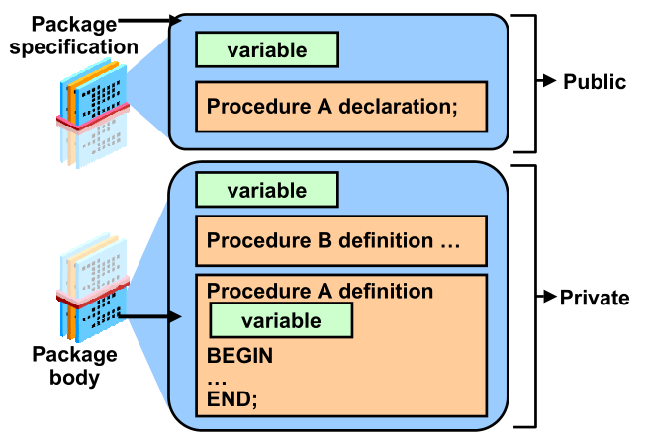
Packages

Slide 14
variables

Slide 15
Variable Types
PL/SQL programs normally are used to manipulate database information. You commonly do this by declaring variables and data structures in your programs, and then working with that PL/SQL-specific data.

Slide 16
Declaring Variables
variable_name [CONSTANT]
datatype [NOT NULL]
[{ := | DEFAULT } initial_value];

Slide 17
Anchored Declarations
Use the %TYPE attribute to anchor the datatype of a scalar variable to either another variable or to a column in a database table or view. Use %ROWTYPE to anchor a record’s declaration to a cursor or table.

Slide 18
Control statements

Slide 19
PL/SQL Control Statements: Conditional
IF-THEN combination
IF condition THEN
executable statement(s)
END IF;
IF-THEN-ELSE combination
IF condition THEN
TRUE sequence_of_executable_statement(s)
ELSE
FALSE/NULL sequence_of_executable_statement(s)
END IF;
IF-THEN-ELSIF combination
IF condition-1 THEN statements-1
ELSIF condition-N THEN statements-N
[ELSE
ELSE statements]
END IF;

Slide 20
IF reminders
Always match up an IF with an END IF
You must have a space between the keywords END and IF
The ELSIF keyword should not have an embedded E
Place a semicolon (;) only after the END IF keywords

Slide 21
PL/SQL Control Statements: Conditional
Simple CASE Expression
CASE region_id
WHEN 'NE' THEN
mgr_name := 'MINER';
WHEN 'SE' THEN
mgr_name := 'KOOI';
ELSE mgr_name := 'LANE';
END CASE;
Searched CASE Expression
CASE
WHEN region_id = 'EAME' THEN
mgr_name := 'SCHMIDT';
WHEN division = 'SALES' THEN
mgr_name := 'KENNEDY';
ELSE mgr_name := 'GUPTA';
END CASE;

Slide 22
PL/SQL Control Statements: Sequential
Simple Loop
LOOP
executable_statement(s)
END LOOP;
Numeric FOR Loop
FOR loop_index IN [REVERSE] lowest_number..highest_number
LOOP
executable_statement(s)
END LOOP;
Cursor FOR Loop
FOR loop_index IN [cursor_name | (SELECT statement)]
LOOP
executable_statement(s)
END LOOP;

Slide 23
PL/SQL Control Statements: Sequential
WHILE Loop
WHILE condition
LOOP
executable_statement(s)
END LOOP;
REPEAT UNTIL Loop Emulation
LOOP
executable_statement(s)
EXIT WHEN boolean_condition;
END LOOP;

Slide 24
cursors

Slide 25
PL/SQL Cursors
Cursors - is a pointer to a private SQL area that stores information about processing a specific SQL statement or PL/SQL SELECT INTO statement. You can use the cursor to retrieve the rows of the result set one at a time.
Implicit cursor is a session cursor that is constructed and managed by PL/SQL. PL/SQL opens an implicit cursor every time you run a SELECT or DML statement. You cannot control an implicit cursor, but you can get information from its attributes.
Explicit cursor is a session cursor that you construct and manage. You must declare and define an explicit cursor, giving it a name and associating it with a query (typically, the query returns multiple rows)

Slide 26
Explicit Cursors
A cursor without parameters
CURSOR company_cur
IS
SELECT company_id FROM company;
A cursor that accepts arguments through a parameter list
CURSOR company_cur (id_in IN NUMBER)
IS
SELECT name FROM company
WHERE company_id = id_in;

Slide 27
Explicit Cursors
To open a cursor:
OPEN cursor_name [(argument [,argument ...])];
The FETCH statement places the contents of the current row into local variables.
FETCH cursor_name INTO record_or_variable_list;
Closing a cursor enables the PL/SQL memory optimization algorithm to release the associated memory at an appropriate time.
CLOSE cursor_name;

Slide 28
Explicit Cursor Attributes
Attribute | Description
%ISOPEN | TRUE/FLASE cursor is opened or not.
%FOUND | INVALID_CURSOR is raised if cursor has not been opened or was closed. NULL before the first fetch. TRUE if record was fetched. FALSE if no row was returned.
%NOTFOUND | The upper cell, but reversed
%ROWCOUNT | INVALID_CURSOR is raised if cursor has not been opened or was closed. The number of rows fetched from the cursor.

Slide 29
Implicit Cursors
Whenever a SQL statement is directly in the execution or exception section of a PL/SQL block, you are working with implicit cursors. SQL statements handled this way include INSERT, UPDATE, DELETE, MERGE, and SELECT INTO. Unlike explicit cursors, implicit cursors do not need to be DECLAREd, OPENed, FETCHed, or CLOSEd.
Implicit cursor attributes are referenced via the SQL cursor.

Slide 30
Implicit Cursor Attributes
Attribute | Description
SQL%ISOPEN | Always FALSE
SQL%FOUND | NULL before the statement. TRUE if one or more rows were inserted, merged, updated, or deleted, or if only one row was selected or FALSE if no rows.
SQL%NOTFOUND | The upper cell, but reversed
SQL%ROWCOUNT | The number of rows affected by the cursor.
SQL%BULK_ ROWCOUNT | Pseudo-associative array (index-by table) containing the number of rows affected by the statements executed in bulk bind operations.

Slide 31
How pl/sql runs

Slide 32
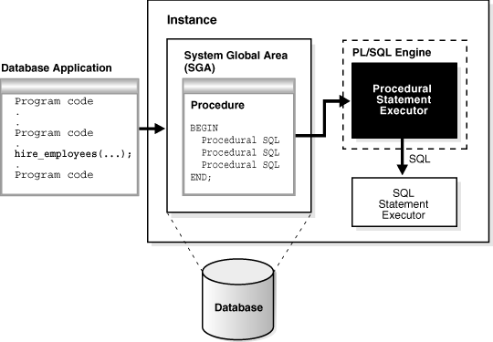
How PL/SQL Runs

Slide 33
Context Switch
Notes:
When the PL/SQL runtime engine processes a block of code, it executes the procedural statements within its own engine, but passes the SQL statements on to the SQL engine. The SQL layer executes the SQL statements and then returns information to the PL/SQL engine, if necessary.
This transfer of control between the PL/SQL and SQL engines is called a context switch. Each time a switch occurs, there is additional overhead. There are a number of scenarios in which many switches occur and performance degrades. As you can see, PL/SQL and SQL might be tightly integrated on the syntactic level, but “under the covers” the integration is not as tight as it could be.

Slide 34
Core PL/SQL
Elias Nema
Senior Software Engineer
Elias_Nema@epam.com

